Slide 1
Challenges of water supply in hilly areas: experience sharing
Pankaj Rai
CEO cum MD Smart city
and Municapal Commissioner, Shimla
Notes:
Good afternoon. Today I am here to share with you the challenges in water supply in hilly areas and our experience in tackling the same

Slide 2
Challenges
Planning
Execution
Operations
Financial
Notes:
Broadly we have two types of water supply schemes, this is gravity and lift. Basically we face challenges at planning level, the execution of various projects, running the operations and of course managing with the limited resources. Today I will take you through our experiences in tackling these challenges.

Slide 3
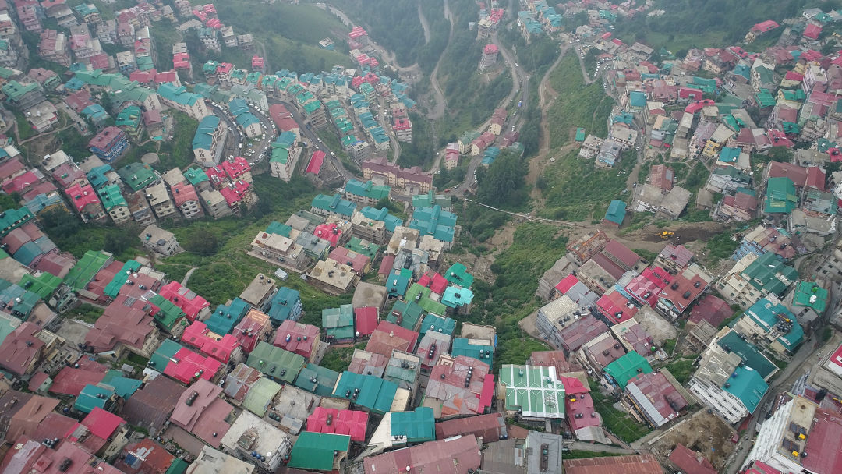
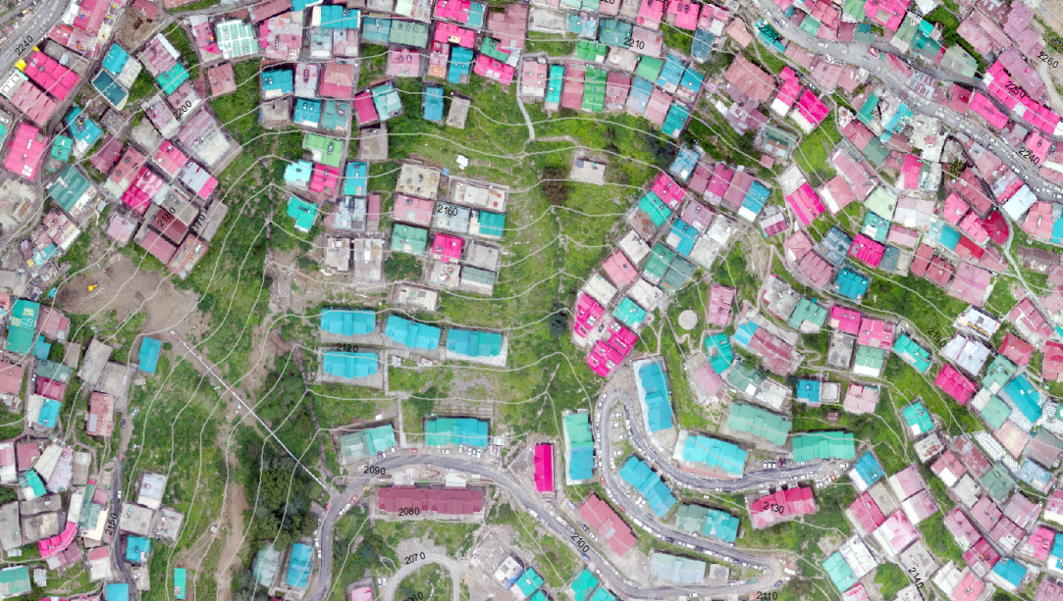
Planning: Conducting surveys
Use of drones for survey
Software for contouring
and mapping
Notes:
Due to the difficult terrain the survey used to be very time consuming and not very accurate. We are now using drones both for surveying, and specific software for overlaying the contouring and mapping of a scheme

Slide 4
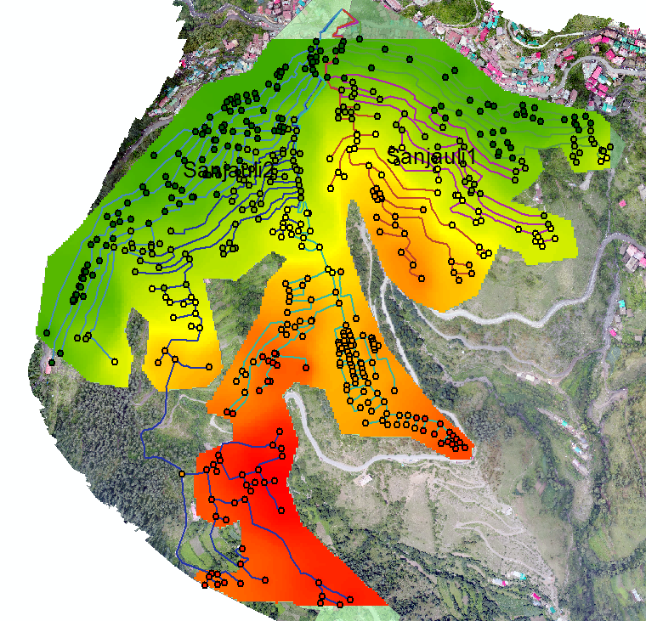
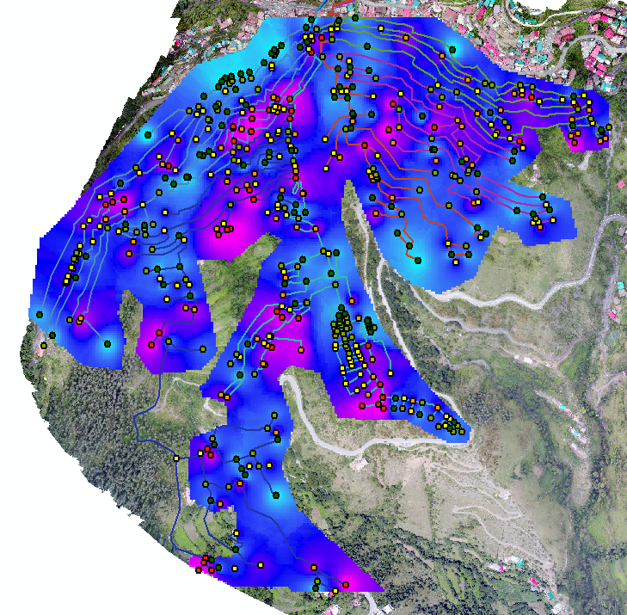
Planning: Water pressure management
Use of Pressure Regulatory valves
Pressures are maintained in the range of 16m to 47m head
Without PRV: Pressures in Sanjauli
With PRV: Pressures in Sanjauli
Notes:
One of the major challenges we face is management of pressure when we supply water to population located at various elevations. For tackling the issue of inequitable distribution we are using pressure regulatory valves. Supervisory Control and Data Acquisition (SCADA) is also being used in some schemes to electronically control water distribution.

Slide 5
Planning: Issues of land availability
Use of compact
technologies
Centrifuges
Tube settlers
Pressure filters
Use of geo-nets
for stabilization
Scarce land
Forest clearances pending for most of the projects
Fragile strata
Notes:
Land for projects in Himachal is scarce and moreover most of our projects are stuck due pending forest clearances. We are now switching over to modern technology for establishing compact projects which minimize land use. For stabilizing the strata we are also using geo-nets to promote plantation.

Slide 6
Challenges in Execution
Material transportation
Heavy material
Lack of access
Installation of pipes
and tanks
Steep slopes
Lack of access
Restricts the use of Tools & Plants
Rope ways-Hamirpur
Planned in Shimla
Light weight material
Cast iron to
high grade steel pipes
Portable Gen-sets
Hand held Pneumatic tools
Portable welding machines
Notes:
The material for projects such as pipes etc are very heavy to transport on slopes and the equipment is difficult to handle. We used ropeways to transport material in some districts and the same is being replicated in Shimla. We are switching from cast iron pipes to steel ones. We now use portable machines such as gen sets, welding machines and pneumatic tools to make our task easier.

Slide 7
Challenges in Operations
Catchment area treatment
Check dams
Plantations
Inter-departmental Coordination
Development works to preserve ecology
20 water samples tested daily at IGMC
Results in public domain
Quarterly virology
Through NIV Pune
Online chlorine sensor in each tank
Continuous pressurized water supply
High turbidity
Flash floods
Water quality
Negative pressure due to Intermittent water supply
Notes:
To tackle the issue of turbidity and flash floods we are constructing check dams and encouraging plantations. We have constituted a inter-departmental coordination committee to ensure developmental works cause minimum ecological damage. For ensuring water quality we check 20 water samples daily and the results are hosted on our website. Quarterly virological testing is being done at NIV Pune. We are installing chlorine sensors in each distribution tank. To ensure that pipes do not suck contaminated material due to negative pressure we are planning continuous supply of water

Slide 8
Challenges: Financial Sustainability
High cost of operation & Maintenance
Heavy subsidy
Generation cost: Rs 102/KL
Supply charges: Rs 15/KL
Energy and Water audits
SOPs for WTP & Pumping operations
NRW controls
Demand management
Social outreach
Notes:
To tackle high cost of operation and maintenance we are conducting regular energy and water audits. By way of audits, we realized, that operating pumps in non-peak hours and replacing worn out pumps would save energy upto 30%. Through water audit we realized 47% water is Non revenue water that is leakage, theft, etc.. We are putting in place standard operating protocols to minimize repair costs. We are also trying to generate awareness to curb wasteful expenditure through social outreach.

Slide 9
Shimla: Case Study
Planning for 2050
Augmentation from 40-44 MLD to 107 MLD
Water from Satluj
Project cost: Rs. 930 Crores
Assistance of World Bank
Timeline: 4 years
Institutional Reform
Satluj Jal Prabahandhan Nigam
Ring fenced structure
Autonomous
Responsible for quality & Quantity
Self sustaining
Notes:
Presently we are supplying water not only to the corporation area but also to adjoining areas. In tourist season the population of the town rises manifolds. Keeping in view the futuristic demand upto the year 2050, we have conceived a ambitious plan by which we plan to augment the daily lifting of water from 44 MLD to 107 MLD by tapping the water from Sutluj River. The project is being established with the assistance of the World Bank with a total outlay of Rs 930 Crores and would be fully functional in another 4 years. We have created Satluj Jal Prabahandhan Nigam limited, a company under the companies act having ring fenced structure, full autonomy, and accountability

Slide 10
Thanks
Notes:
I thank you for your patient listening

